Slide 1
Lecture 3
OS Overview
National University of
Computer & Emerging Sciences

Slide 2
The Operating System controls the machine
gcc
gdb
User
OS Kernel
grep
diff
Application
Hard
ware
vi
date
Operating System
xterm
emacs
Hardware
netscape

Slide 3
A better picture
Many
applications
Application
One Operating
System
System
calls
Operating
System
One Hardware
Hardware

Slide 4
Operating System in Action
OS is a program, just like any other program
When you turn power on, bootstrap program is loaded from ROM
Boot program
  Examine/check machine configuration
    # CPUs
    How much memory
    # and type of HW devices
  Build configuration structure describing the HW
  Locates and Loads the OS
  The control transfers to the OS
Notes:
POST, display info, access and check boot loader and load in RAM

Slide 5
Operating System in Action
Operating System:
Initialize kernel data structures
Initialize state of HW devices
Creates a number of processes to start operation

Slide 6
Components of an OS

Slide 7
Common System Components
Process Management
Main Memory Management
File Management
I/O System Management
Secondary Management
Networking
Protection System
Command-Interpreter System

Slide 8
Process Management
Creation/deletion of a process
Create and make available, an execution environment
Suspension/resumption and CPU scheduling in a fair manner
Mechanisms for synchronization
Mechanisms for inter-process communication
Deadlock handling

Slide 9
Operating System Services

Slide 10

A View of Operating System Services

Slide 11
Operating System Services
Program execution – system capability to load a program into memory and to run it
I/O operations – since user programs cannot execute I/O operations directly, the operating system must provide some means to perform I/O
File-system manipulation – program capability to read, write, create, and delete files
Communications – exchange of information between processes executing either on the same computer or on different systems tied together by a network. Implemented via shared memory or message passing
Error detection – ensure correct computing by detecting errors in the CPU and memory hardware, in I/O devices, or in user programs

Slide 12
A View of Operating System Services

Slide 13
System Calls
Programming interface to the services provided by the OS
Typically written in a high-level language (C or C++)
Mostly accessed by programs via a high-level Application Program Interface (API) rather than direct system call use
Three most common APIs are Win32 API for Windows, POSIX API for POSIX-based systems (including virtually all versions of UNIX, Linux, and Mac OS X), and Java API for the Java virtual machine (JVM)

Slide 14

Example of System Calls
System call sequence to copy the contents of one file to another file

Slide 15

API – System Call – OS Relationship

Slide 16
Dual-mode operation
Dual-mode operation allows OS to protect itself and other system components
  User mode and kernel mode
  Mode bit provided by hardware
    Provides ability to distinguish when system is running user code or kernel code
    Some instructions designated as privileged, only executable in kernel mode
    System call changes mode to kernel, return from call resets it to user
Notes:
Dual mode is an important aspect, that is used to protect OS and other components from unprivileged intervention.

Slide 17

Transition from User to Kernel Mode

Slide 18

Standard C Library Example
C program invoking printf() library call, which calls write() system call

Slide 19
System Call Parameter Passing
methods used to pass parameters to the OS
  Simplest: pass the parameters in registers
    In some cases, may be more parameters than registers
  Parameters stored in a block, or table, in memory, and address of block passed as a parameter in a register
    This approach taken by Linux and Solaris
  Parameters placed, or pushed, onto the stack by the program and popped off the stack by the operating system
  Block and stack methods do not limit the number or length of parameters being passed

Slide 20
Types of System Calls
Process control
File management
Device management
Information maintenance
Communications
Protection

Slide 21

Examples of Windows and Unix System Calls

Slide 22
Operating System Design and Implementation

Slide 23
Simple Structure
MS-DOS – written to provide the most functionality in the least space
  Not divided into modules
  Although MS-DOS has some structure, its interfaces and levels of functionality are not well separated

Slide 24
Non Simple Structure -- UNIX
UNIX – limited by hardware functionality, the original UNIX operating system had limited structuring. The UNIX OS consists of two separable parts
Systems programs
The kernel
  Consists of everything below the system-call interface
and above the physical hardware
  Provides the file system, CPU scheduling, memory management, and other operating-system functions; a large number of functions for one level
Operating System Concepts – 9th Edition
2.<number>
Silberschatz, Galvin and Gagne ©2013

Slide 25
Traditional UNIX System Structure
Beyond simple but not fully layered

Slide 26

MS-DOS Layer Structure

Slide 27

Layered Operating System

Slide 28
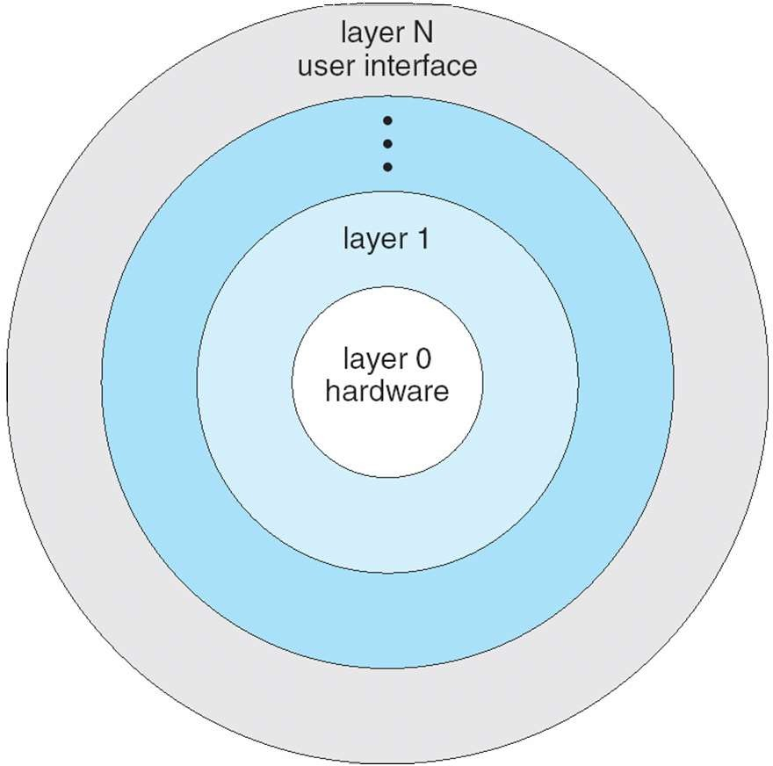
Layered Approach
Break operating system into pieces
Each layer interacts only with its lower layer
Benefits
  Allows to built modular systems
  Can exchange each layer
  Facilitates testing
    Look at each layer separately
Drawback
  Difficult to define appropriate layers
  Sometimes contradictory needs
  Tends to be less efficient
1-Introduction
26

Slide 29
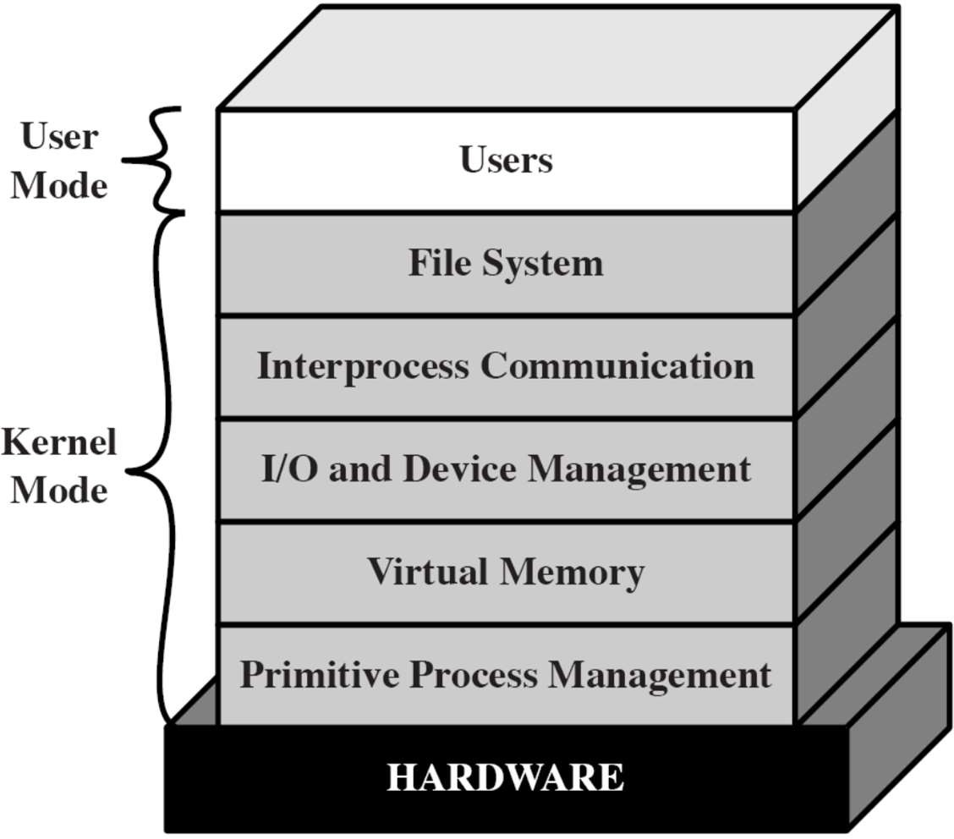
Layered Approach – Example
1-Introduction
27

Slide 30
Microkernel System Structure
Moves as much from the kernel into user space
Mach example of microkernel
  Mac OS X kernel (Darwin) partly based on Mach
Communication takes place between user modules using
message passing
Benefits:
  Easier to extend a microkernel
  Easier to port the operating system to new architectures
  More reliable (less code is running in kernel mode)
  More secure
Detriments:
  Performance overhead of user space to kernel space
communication
Operating System Concepts – 9th Edition
2.<number>
Silberschatz, Galvin and Gagne ©2013

Slide 31
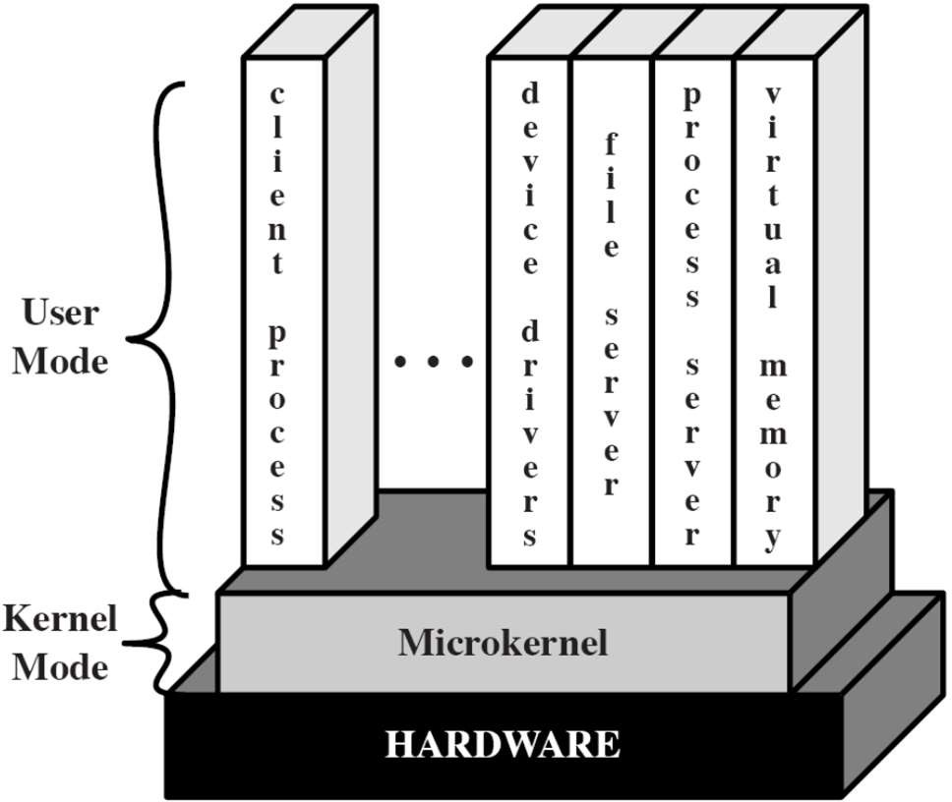
Microkernel
Small OS core – contains only essential OS functions
  Low-level memory management
  Process scheduling
  Communication facility
Many services traditionally included in the OS kernel are now external subsystems
  Device drivers, file systems, virtual memory manager, windowing system, security services
  Run in user mode
1-Introduction
28

Slide 32
Microkernel System Structure
Application Program
Device Driver
File System
user mode
messages
messages
Interprocess Communication
memory managment
CPU
scheduling
kernel mode
microkernel
hardware
Operating System Concepts – 9th Edition
2.<number>
Silberschatz, Galvin and Gagne ©2013

Slide 33
Microkernel
Corresponds to client/server model
  Communication takes place between user modules using message passing
Benefits
  Easier to extend a microkernel
  Easier to port the operating system to new architectures
  More reliable (less code is running in kernel mode)
  More secure
Detriments
  Performance overhead of user space to kernel space communication
1-Introduction
29

Slide 34
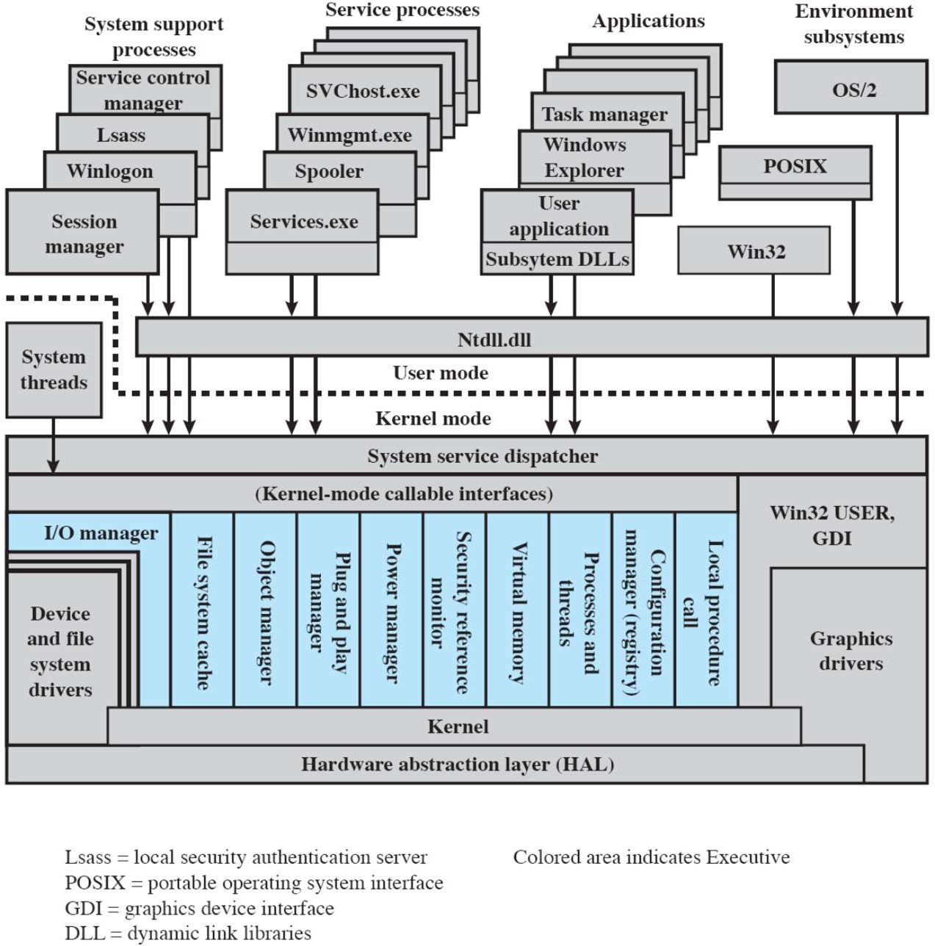
Windows 2000
Client/Server computing
Modified microkernel architecture
  Not a pure microkernel: many system functions outside of the microkernel run in kernel mode
  Modules can be removed, upgraded, or replaced without rewriting the entire system
1-Introduction
30

Slide 35
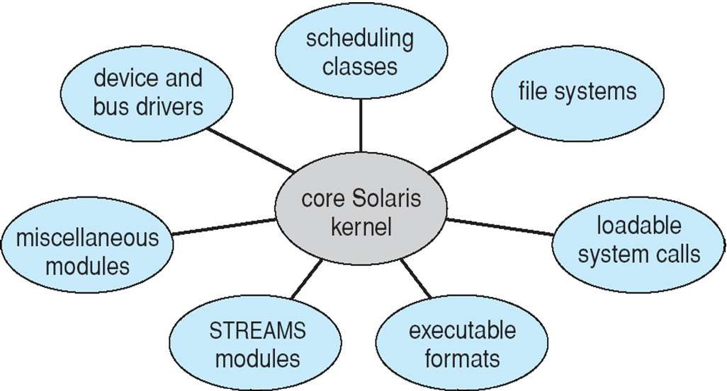
Modules
Solaris Modular Approach
Most modern operating systems implement kernel modules
  Each core component is separate
  Each talks to the others over known interfaces
  Each is loadable as needed within the kernel
Overall, similar to layers but with more flexible
1-Introduction
31

Slide 36
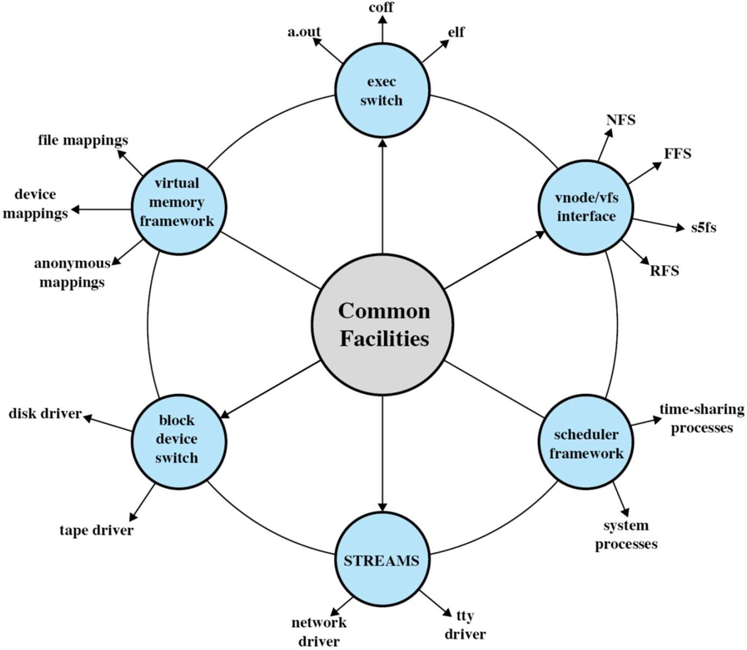
Modular Approach in Modern UNIX Instances
Kernel set of core facilities
Modules can be dynamically linked during run time
Modern Unix approaches, e.g., Solaris follow a modular organization
1-Introduction
32

Slide 37

Solaris Modular Approach

